Slide 1
BLACK FRIDAY Project
Only eda -> exploratory data analysis

Slide 2
Problem Statement
A retail company “ABC Private Limited” wants to understand the customer purchase behaviour (specifically, purchase amount) against various products of different categories. They have shared purchase summary of various customers for selected high volume products from last month. The data set also contains customer demographics (age, gender, marital status, city_type, stay_in_current_city), product details (product_id and product category) and Total purchase_amount from last month. Now, they want to build a model to predict the purchase amount of customer against various products which will help them to create personalized offer for customers against different products.

Slide 3
Data Variable Definition
• User_ID User ID
• Product_ID Product ID
• Gender Sex of User
• Age Age in bins
• Occupation Occupation (Masked)
• City_Category Category of the City (A,B,C)
• Stay_In_Current_City_Years Number of years stay in current city
• Marital_Status Marital Status
• Product_Category_1 Product Category (Masked)
• Product_Category_2 Product may belongs to other category also (Masked)
• Product_Category_3 Product may belongs to other category also (Masked)
• Purchase Purchase Amount (Target Variable)

Slide 4
Goal
Our goal is to predict the purchase amount of customer against various products.
We have to EDA properly and to create personalized offer for customers against different products.

Slide 5
About dataset
Here , We have 550068 Rows and 121Columns
We have null values in 2 Columns
We have Duplicated Value and we remove that.
We have 5 Object Type data type and 5 integer type data type and 2 float type (float type because it contains null values)
This Data Usage 54.6+ MB storage .

Slide 6
NULL VALUES
As we know we have 2 Columns with Nan Values . So we don’t think to delete this right . First I do EDA Then I will take my action against Nan values. Lets See Column Who have Nan Values.
Total Rows -> 550068
1 -> Product_Category_2 -> 173638 Null Values
2-> Product_Category_3 -> 383247 Null Values
So, I decided to not delete Nan values and move foreword to EDA . To se exact behaviour of customers.

Slide 7
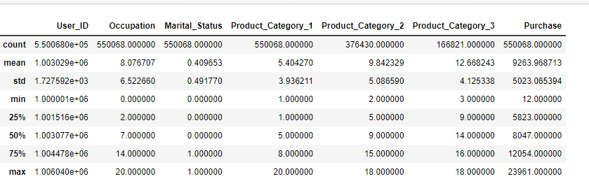
Data description
As pe my Observation :-
All the data is Normally distributed . And Purchase contain some outliers but I don’t take as a outliers.
Only Purchase is a Continious Data and left are Descrete Data type. And only Gender is Object .
Here we cannot see City Category , Stay_In_Current_City_Years , Age because its contain “+” Sign
Here we confirm that we have outliers in 2 columns.

Slide 8
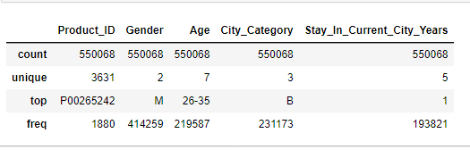
DATA DESCRIPTION INCLUDE ObJECT
Product id have 3631 Unique values .
Gender has 2 Unique Values
City_Catefory 3 Unique Values
Stau_in_Current_City_Years have 5 unique columns

Slide 9
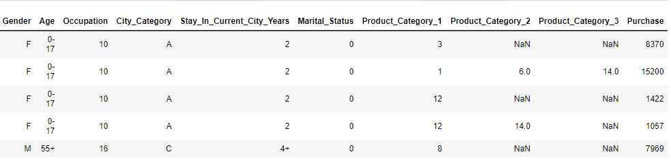
Eda -> exploratory data analysis univariate
Lets look a dataset and columns.

Slide 10
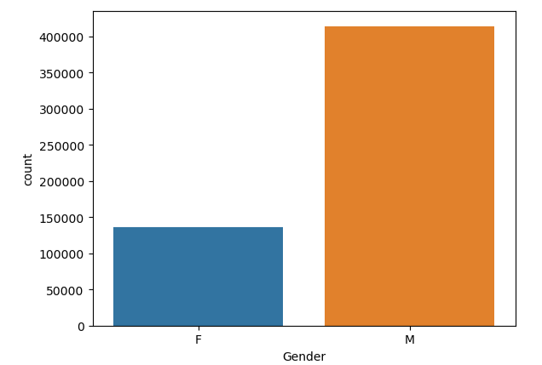
Lets plot Gender
So, Here we can see that Male is More in Count 414259 and Female are Less in count 135809.

Slide 11
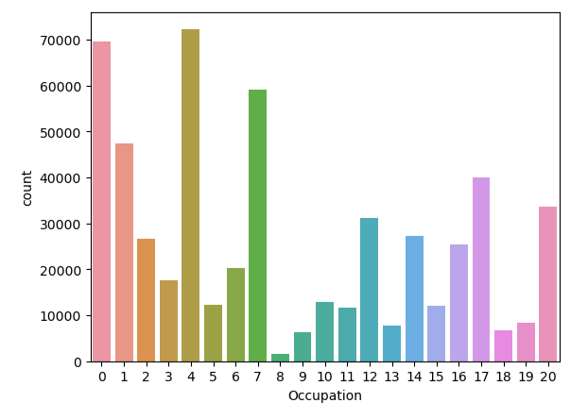
Lets plot Occupation
- So, Here Maximum People Occupied with Occupation - 4 then 0 then 7 then 1 then 17 then 20 then 20 then 12 and so on.
- Least People Occupied with Occupation - 8 then 9 then 18 then 18 then 13 then 19 then 11 and so on

Slide 12
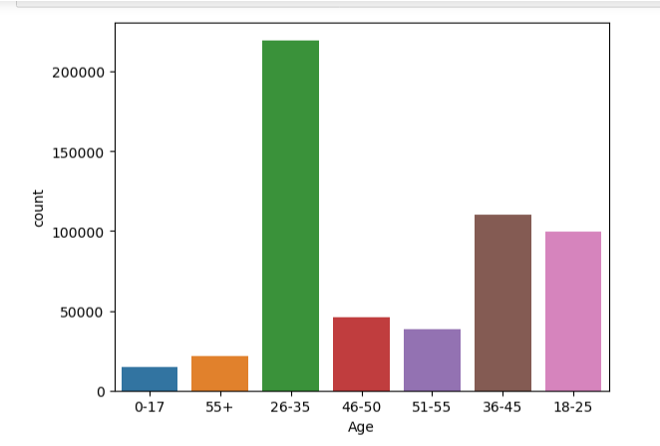
Lets plot Age
Here , We can see that Maximum People Order Place From 26-35 Age Group then 36-45 then 18-25. , and 18-25 and
Least People From 0-17 then 55+ then 51-55 then 46-50.

Slide 13
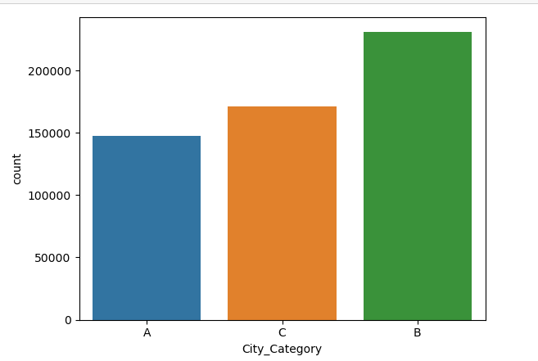
LETS PLOT City_Categor
Here we can see that maximum order place from City B then C and then A .

Slide 14
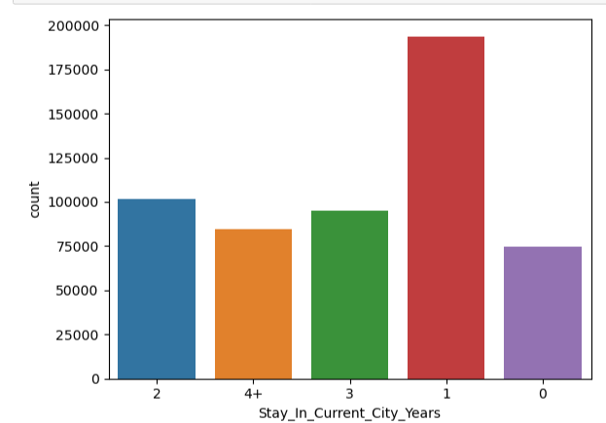
Lets plot Stay_In_Current_City_Years
Here , We can see that Which People Stay from 1 Year who are shoping more and then Who live from 2 year they are most order and then who live from 3 and then who live from more then 4 year and least order place from who live from less then 1 year.

Slide 15
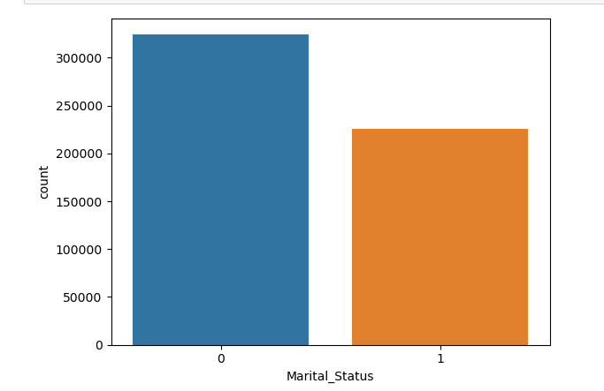
Lets plot Marital_Status
Here , We can see Martial Status for 0-324731 Counts and 1- 225337 Counts

Slide 16
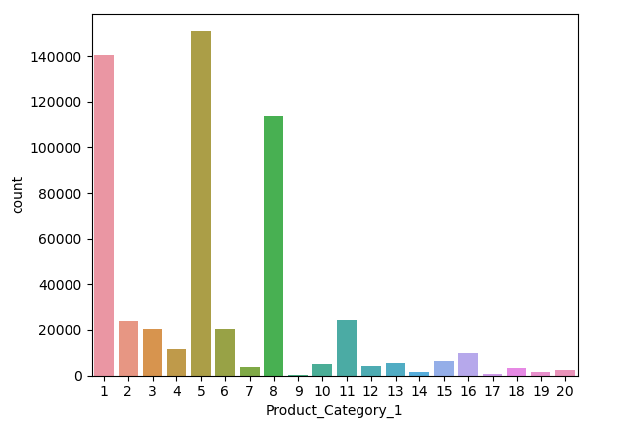
Lets plot Product_Category_1
Maximum ordered Product is 1 , 5 , 8 ,11 , 2,6,3 and 4 and
Least is Product - 9,17, 14 , 19 ,20, 18, 7, ,12 ,10, 13, 15 and 16.

Slide 17
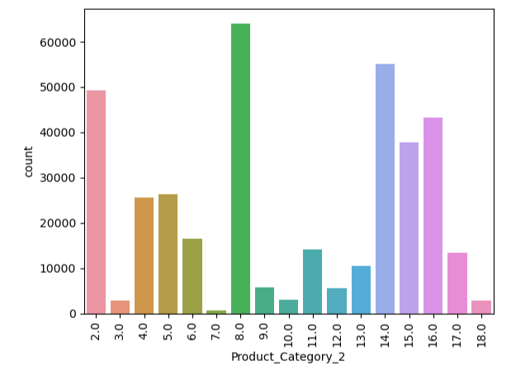
Lets plot Product_Category_2
Here We, can see that product 8.0,14.0,2.0,16.0 is maximum sale in Product category 2 and
Least Order Product is 7.0 and 18,3.0,10.0,12.0 and 9.0
Product_Category_2 Contain Null Values of Counts -> 173638

Slide 18
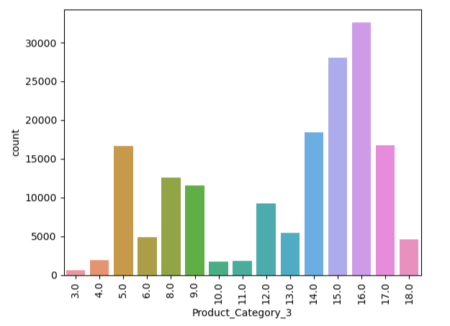
Lets plot Product_Category_3
So, Product 16.0,15.0,14.0,17.0,5.0,8.0, and 9.0 is Maximum sale in Product Category 3 and
Least is 3.0,10.0,11.0,4.0,18.0 and 6.0
Product_category_3 Cotain Null values of counts 383247 (Big Number ) Safe to delete this column

Slide 19
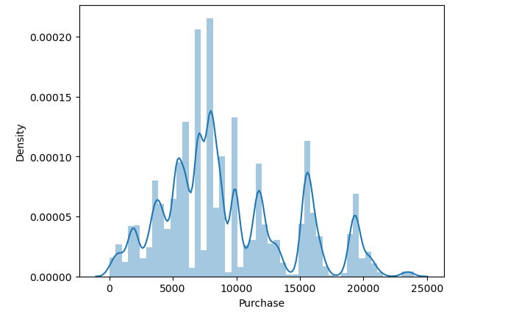
Lets plot Purchase (Distribution plot)
Here , We can see that Purchase Column is not a normally distributed . So, Lets see fpr outliers.

Slide 20
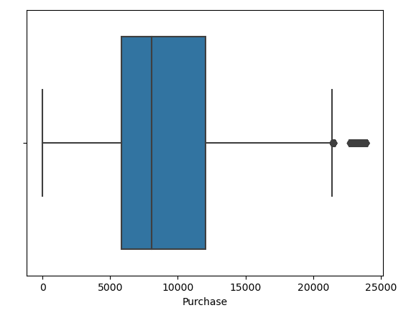
Lets plot Boxplot for Purchase
So, Here we can see that we have outliers of . but we dont keep as outliers because some people also shooping for high price product. So we keep this ourliers.

Slide 21
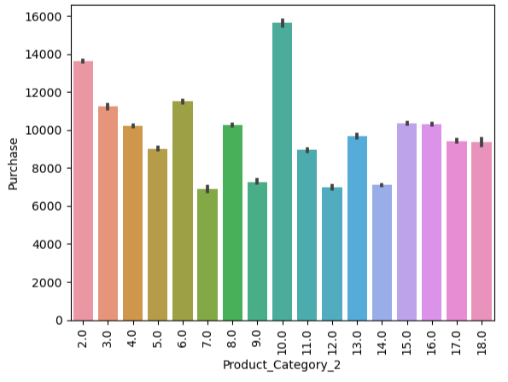
BIVARIATE ANALYSIS Lets plot Product Category 2 with Purchase
Here , We can see that Product_Category_2 Maximum Price Product is , Product 10.0 then 2.0 then 6.0 then 3.0 then 15 and 16.
Least Costly Product is, Product 7.0 then 12.0,then 14.0 then 11.0 So on..

Slide 22
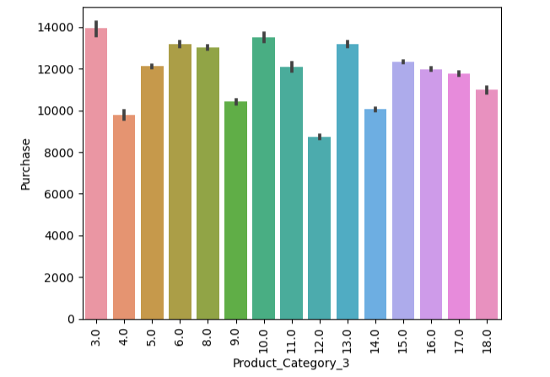
Lets plot Product Category 3 with Purchase
Here , We can see that Product_Category_3 Maximum Price Product is , Product 3.0 then 10.0 then 14.0 then 6.0 then 8.0 and 15.0.
Least Costly Product is, Product 12.0 then 4.0,then 14.0 then 9.0.0 So on..

Slide 23
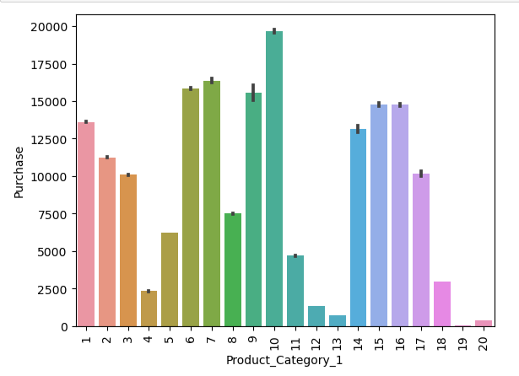
Lets plot Product Category 1 with Purchase
Here , We can see that Product_Category_1 Maximum Price Product is , Product 10.0 then 7.0 then 6.0 then 6.0 then 9.0 then 15.0 and 16 .
Least Costly Product is, Product 19.0 then 20.0,then 13.0 then 12.0 then 4.0 then 18 then 11 and 5 .

Slide 24
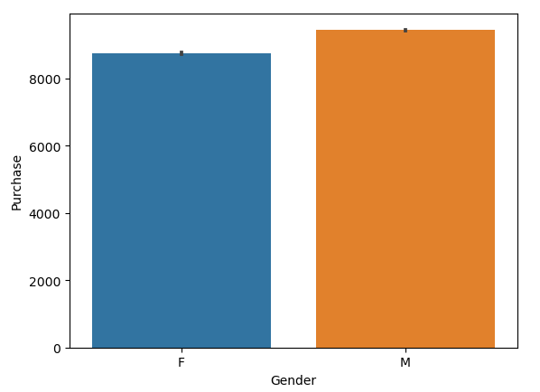
Lets plot Gender and Purchase
So, Here we can see that Male are speding more money .in shopping .
“If You Notice once thing when we plot count of gender then we see Female are very to compare with male . But when we plot a gender with purchase we can observe female in less in counts but less female spend her amount almost equal to Male. “

Slide 25
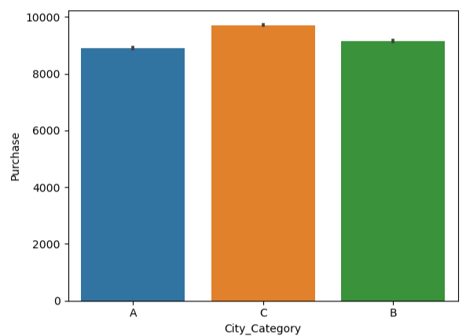
Lets plot City and Purchase
Here we can see that From city C maximum order are make. then B then A are make orders

Slide 26
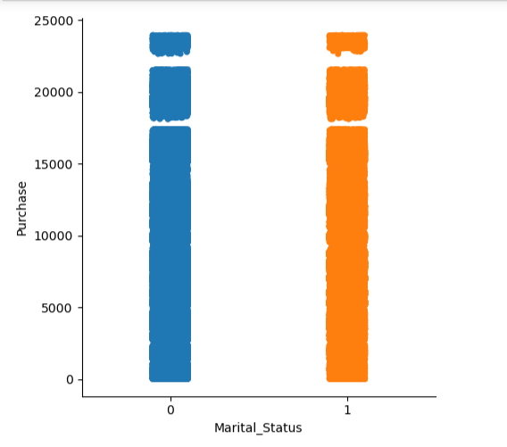
Lets plot Martial status with Purchase
Here , We can see that Married and Unmarried Purchare amount are almost spend same amount.

Slide 27
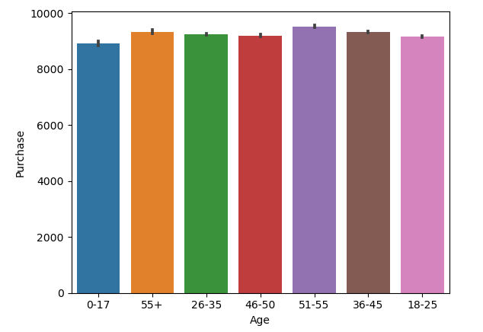
Lets plot Age and Purchase
Here , We can see that Maximum money spend from 51-55 age group then 55+ then 36-45 and 18-25 are same then 0.-17

Slide 28
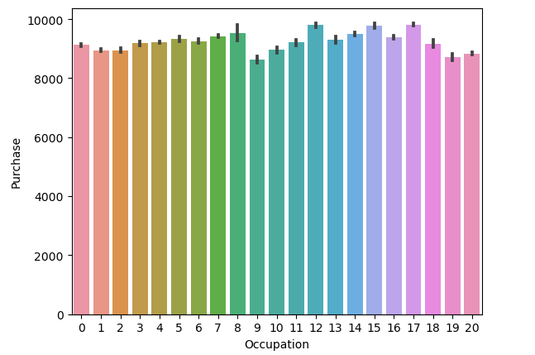
Lets plot Occupation and Purchase
So, Here maximum spended Occupation 17 then 12 then 15 then 8 then 7 then 5 and 7 . and Least Money spend from Occupation 9 then 19and 1 then 20 and 2 then 0.

Slide 29
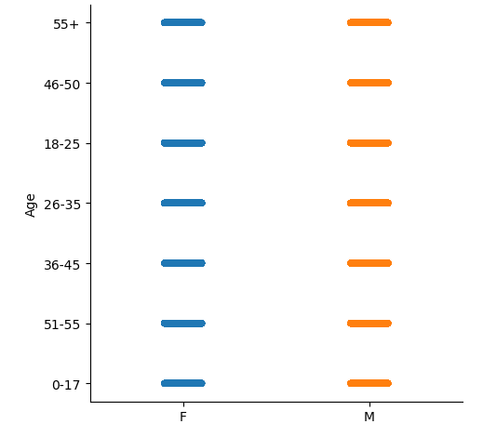
Lets plot Age and Gender
Here we can see that. Female and Male is equal in all age groups.

Slide 30
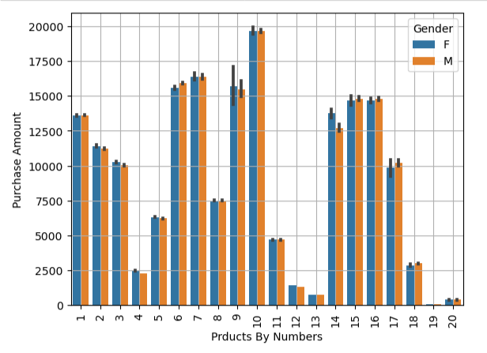
Multivariate analysis Lets plot Product Category 1 with Purchase with Gender
So, Here We can see that Maximum Price Product - 10 then 7 then 6 then 15 and 16 male and female order in almost same amount
Least Price Product -> 19 then 20 then 13 then 12 then 4 then 18 then 11 the 5.male and female order in almost same amount

Slide 31
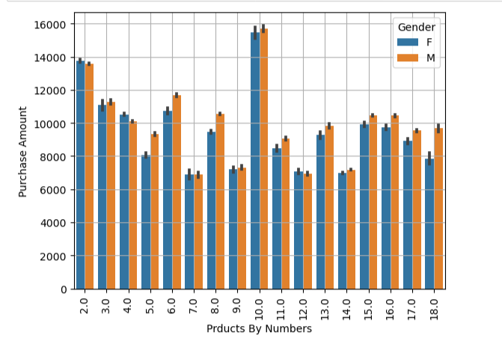
Lets plot Product Category 2 with Purchase with Gender
So, Here we can see that for .
Maximum Price Product ,
Product 10 -> Mamimum Order by Male and then Female
Product 2.0 -> Maximum Order By Female then Male
Product 6.0-> Maximum Order By Male then Female
Product 3.0 -> Maximum Order By Male then Female
Product 4.0 -> Maximum Order by Female then Male
Product 15.0, 16.0 -> Maximum Order By male and then Female
Less Price Product ->
Product 7.0 -> Equally Order by male and Female
Product 12.0 -> Maximum order by female then male
Product 14.0 -. Maximum order by Male then Female
Product 18.0 -. Maximum order by Male then Female

Slide 32
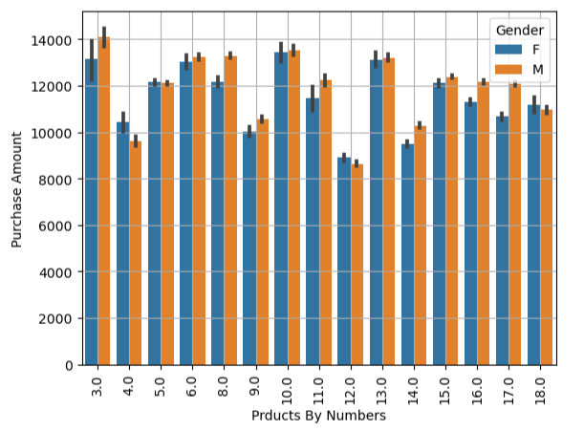
Lets plot Product Category 3 with Purchase with Gender
So, Here we can see that for .
Maximum Price Product ,
Product 3 -> Mamimum Order by Male and then Female
Product 10 -> Maximum Order By Male and then Female
Product 6.0-> Maximum Order By Male then Female
Product 13 -> Maximum Order By Male then Female
Product 8.0 -> Maximum Order by Male then Female
Product 11.0 -> Maximum Order By Male then Female
Product 5.0 -> Maximum Order By Female then Male
Product 18.0 -> Maximum Order By Female then Male
Less Price Product ->
Product 4.0 -> Maximum order by female then male
Product 12.0 -> Maximum order by female then male
Product 14.0 -. Maximum order by Male then Female
Product 18.0 -. Maximum order by Male then Female
Product 9.0 -. Maximum order by Male then Female

Slide 33
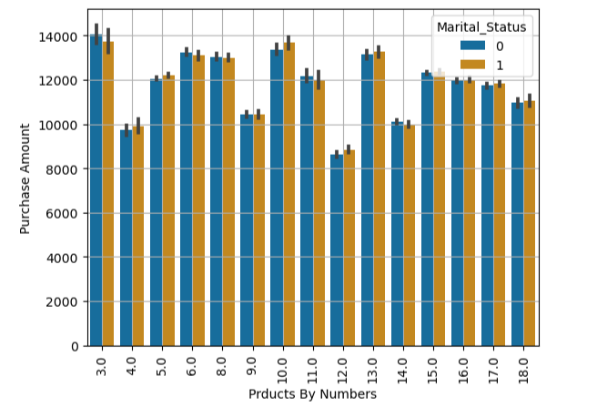
Lets plot Product Category 3 with Purchase with Martial Status
So, Here we can see that for .
Maximum Price Product Order By Married or UnMarried ,
Product 3 -> Mamimum Order by 0 and then 1
Product 10 -> Maximum Order By 1 and then 0
Product 6.0-> Maximum Order By 0 then 1
Product 13 -> Maximum Order By 1 then 0
Product 8.0 -> Equally order by 0 and 1
Product 11.0 -> Maximum Order By 0 then 1
Product 5.0 -> Maximum Order By 1 then 0
Product 18.0 -> Maximum Order 1 Female then 0
Less Price Product ->
Product 4.0 -> Maximum order by 1 then 0
Product 12.0 -> Maximum order by 1 then 0
Product 14.0 -. Maximum order by 0 then 1
Product 18.0 -. Maximum order by 1 then 0
Product 9.0 -. Maximum order by 0 then 1

Slide 34
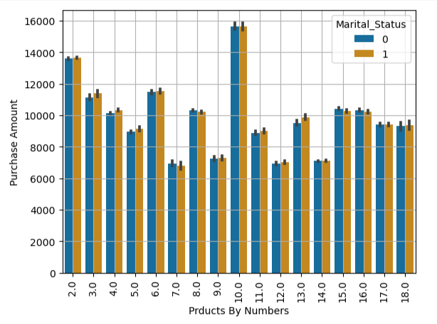
Lets plot Product Category 2 with Purchase with Martial Status
So, Here we can see that for .
Maximum Price Product ,
Product 10 -> Equal order by 0 and 1
Product 2.0 -> Maximum Order By 1 then 0
Product 6.0-> Equal order by 0 and 1
Product 3.0 -> Maximum Order By 1 then 0
Product 4.0 -> Maximum Order by 1 then 0
Product 15.0, 16.0 -> Maximum Order By 0 and then 1
Less Price Product ->
Product 7.0 -Maximum order by 0 then 1
Product 12.0 -> Maximum order by 1 then 0
Product 14.0 -> Equal order by 0 and 1
Product 18.0 -> Equal order by 0 and 1

Slide 35
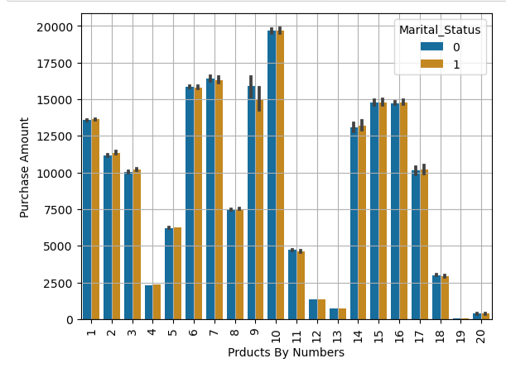
Lets plot Product Category 1 with Purchase with Martial Status
So, Here We can see that Maximum Price Product - 10 then 7 then 6 then 15 and 16 male and female order in almose same amount
Least Price Product -> 19 then 20 then 13 then 12 then 4 then 18 then 11 the 5.male and female order in almose same amount

Slide 36
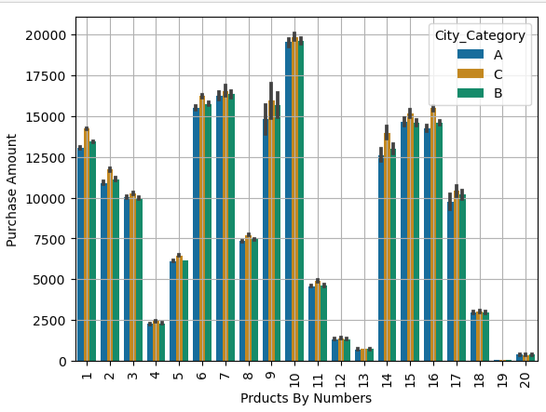
Lets plot Product Category 1 with Purchase with City Category
So, Here we can see that Maximum Price Product Order From -> C city then B the A .
and Some Products Like 12, 13, 20, 18 and 19 which are order same in all city

Slide 37
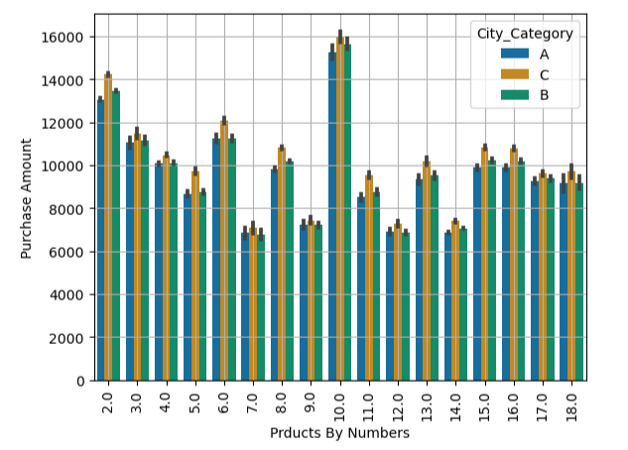
Lets plot Product Category 2 with Purchase with City Category
So, Here we can see that Maximum Price Product Order From -> C city then B the A .
and Some Products Like 18,17,5,4,and 3 order same by City C and B

Slide 38
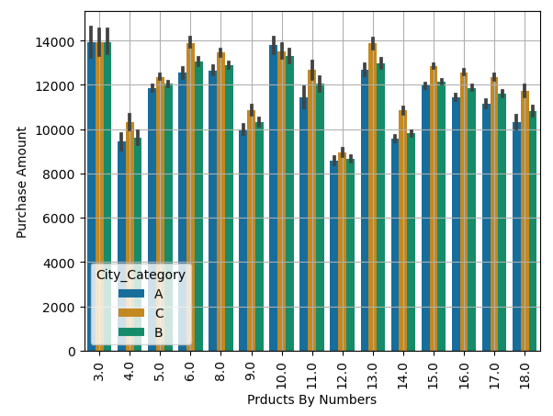
Lets plot Product Category 3 with Purchase with City Category
So, Here we can see that Maximum Price Product Order From -> C city then B the A .
and Product 3.0 -> Is Equally Order by city A , B and C .
and Product 11 the only product which is order by City A compare to City B and C .

Slide 39
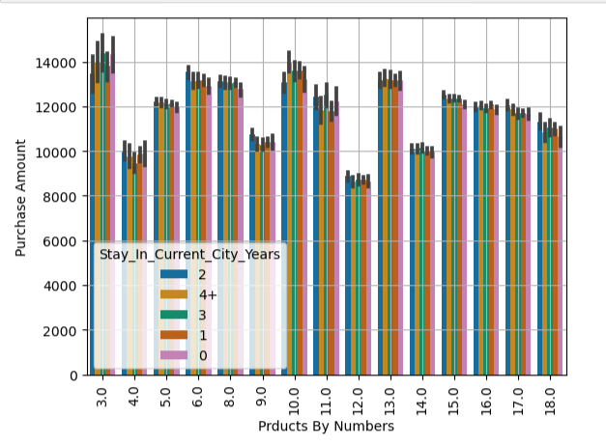
Lets plot Product Category 3 with Purchase with Stay_In_Current_City_Years

Slide 40
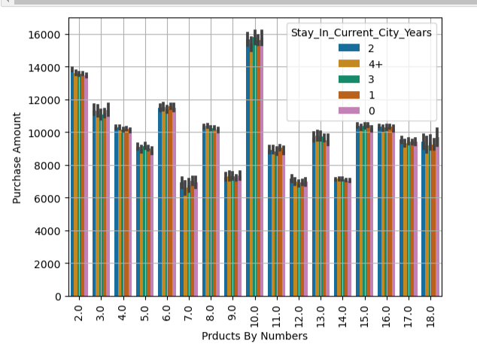
Lets plot Product Category 2 with Purchase with Stay_In_Current_City_Years

Slide 41
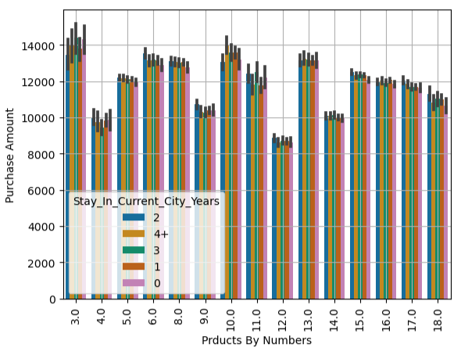
Lets plot Product Category 3 with Purchase with Stay_In_Current_City_Years

Slide 42
cOnCLUSION
If you see in Slide -10 then you can see the counts of Male – 414259 and Female-135809 . And after that you can see in Slide 30, 31 and 32 . that the graph of all Products with his Price and hue by Gender. And you can find there . For all product female and male both are equal in counts. So its means is all the peoples are shopping in Black Friday..
If we include the City also. the count of A, B and C city. So that is not properly balanced but if see the hue with Product and Price Then we can find all the cities order same counts for all the products.
Black Day is a Shopping Day for Western and Eastern Countries. And Now we can see which which product needed more in this Black Day.

Slide 43
Conclusion
So , Most of People Come From Occupation 4 then 0 then 7 then 1 then 17 then 20 then 20 and 12 .(Slide 10)
Maximum Ordered Product for Product_Category_1 is 1 , 5 , 8 ,11 , 2,6,3 and 4
Least Order Product -> 9,17, 14 , 19 ,20, 18, 7, ,12 ,10, 13, 15 and 16 .(Slide ->16)
Maximum Ordered Product for Product_Category_2 is 8.0,14.0,2.0,16.0
Least Order Product -> is 7.0 and 18,3.0,10.0,12.0 and 9.0. (Slide->17)
Product_Category_2 Contain Null Values of Counts -> 173638
Maximum Ordered Product for Product_Category_3 is 16.0,15.0,14.0,17.0,5.0,8.0, and 9.0
Least is 3.0,10.0,11.0,4.0,18.0 and 6.0 (Slide->18)
Product_category_3 Cotain Null values of counts 383247 (Big Number ) Safe to delete this column

Slide 44
In Slide 27 You can see that Maximum money spend from 51-55 age group then 55+ then 36-45 and 18-25 are same then 0 -17. If you see in the Graph then you can see that all age group Shopping in equal in counts. So you have to focus for age category products.
We don’t check for outliers and Distribution plot for all columns because we don’t need to check because column are Float and Int Type but it’s a Categorical data .
And I decide to fill null or remove null after model building in both types. Without null or fill null. So then I decide null is important or not.
Happy Black Friday to You and Your Customer.
Thankyou 😉 😉

